Slide 1
Automating Survey Creation from Apollo QUAL Word Documents in Decipher Mladen Srzic – Apollo (SHG) QUAL - Programming

Slide 2
Explanation of the Title: Automating Survey Creation from Apollo QUAL Word Documents in Decipher
Automating Survey Creation
Means reading Word Survey Document and producing automated XML and Python code (jQuery could also be added). Also, the program has tools for solving logic and termination, so it is not only for importing questions.
QUAL
Could be extended to QUANT but that is for some other stage of development
Apollo Word Documents
Means mainly SHG but could be implemented for InCrowd documents as well
Decipher
It can be modified for other survey software that does not have only GUI access (e.g. XML Editor, database (SQL), …)

Slide 3
First questions: What does this mean for us as developers and our department
Can this replace people and needs for programmers
ANSWER: NO WAW!!! It can only serve as an assistant tool to improve work
It is not AI
The program works exclusively on the recognition of questionnaire elements: variable, title, comment, answers, and termination commands
Main Technology Used
Python and python-docx module that work with Word Documents Objects (Document, Paragraph, Table)
Collaboration
The whole project is open for sharing, collaboration, improvement …
IDEA!!!
This should all be seen as an open mind idea, but an idea that also has its own prototype(working solution). Things are changeable, addable, extendable

Slide 4
Automating Survey Creation - Main Goals
One of the main goals
one of the goals is to automate, especially routine parts of the job so that we can better concentrate on more complex and difficult tasks in our projects
Systematicity can be improved
once one task is overcome, we don't have to repeat it again, i.e. solving certain patterns and types of questions can be permanently facilitated.
Copy/Paste
reduction of copy/paste and switching from one place to another during the concrete project production
Errors
This solution can reduce errors and help while debugging

Slide 5
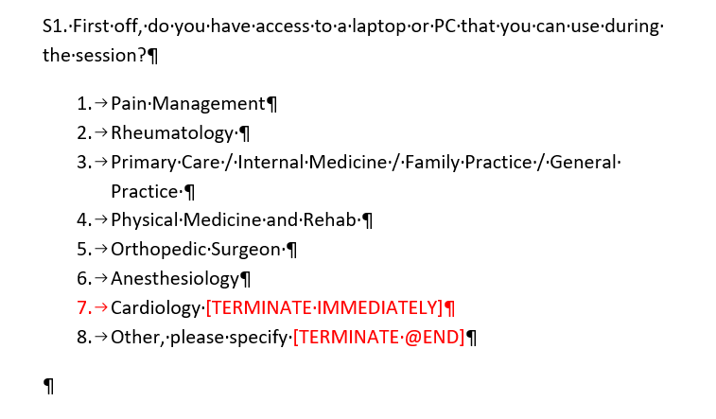

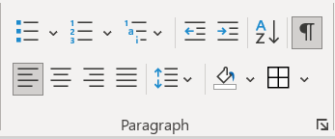
How it works: Looping Paragraphs in Word
Paragraphs
Show/Hide

Slide 6
How it works: Recognitions of elements (1)
Where a new question starts?
if the first word in the paragraph is a letter and contains number new question is started
if the first word in the paragraph start with a number it is a new answer

Slide 7
How it works: Recognitions of elements (2)
Question variable
Title
question’s instruction are in [] brackets after the title
[cond: S01.r1]
[comment: Select one.]
answer’s number
answer’s label
answer’s instruction

Slide 8
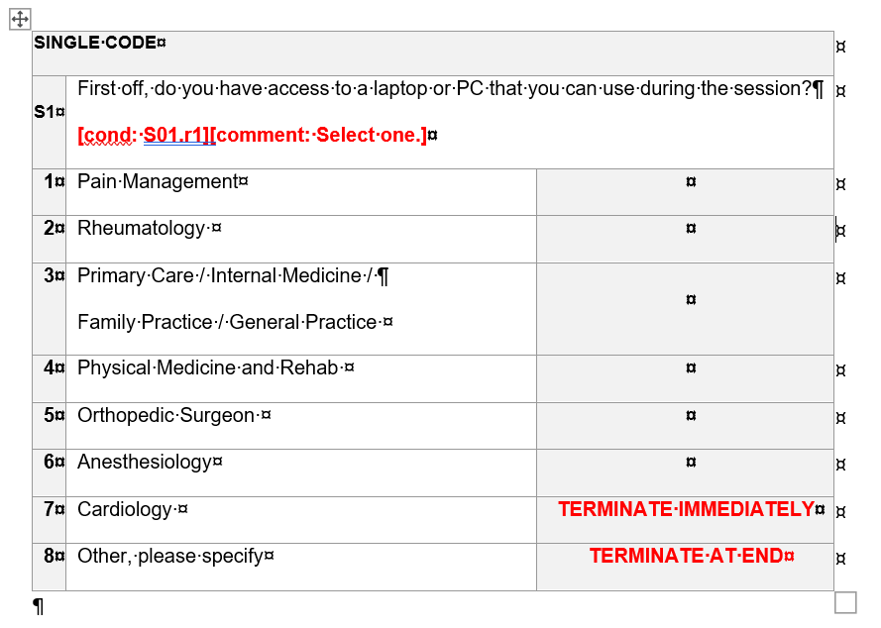
How it works: Looping Tables in Word
Now, the whole row is treated as one paragraph
a paragraph inside the table cell problem can be solved
special keyword solves XML syntax for open input text and also validation for numeric question
instructions start from 3rd column

Slide 9
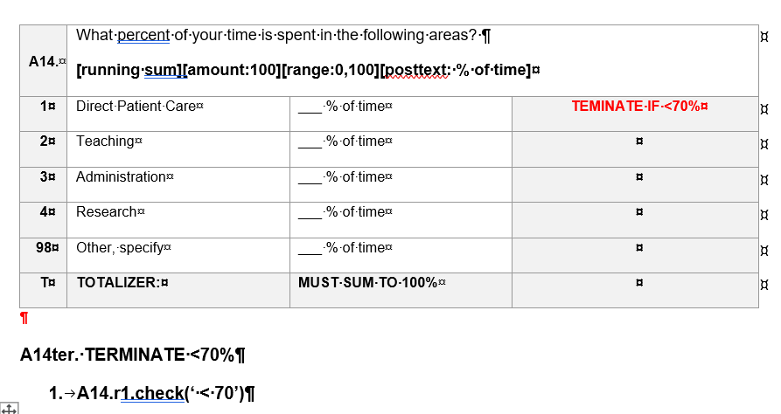
Example: frequent numerical question (1)
Orders added in brackets []
<validate>
x=A14.r98.ival
y=A14.r98.open
if x&gt;0 and y=="": error(res.otherx)
if y!="" and x==0: error(res.othery);
</validate>
Other specify in a numeric question generate validation tag
More complicate terminations are solved as separate questions
Condition: <condition label="Disp9" cond="S14.r1.check('&lt;70')">Conditional Disposition 9 </condition>
TermList: <row label="r9" value="9">S14 </row>
Termination:
<note> Original Cond=S14.r1.check('&lt;70')</note>
<term label='Term2' cond="(processTerms('Disp9') )"> Terminate S14 </term>

Slide 10
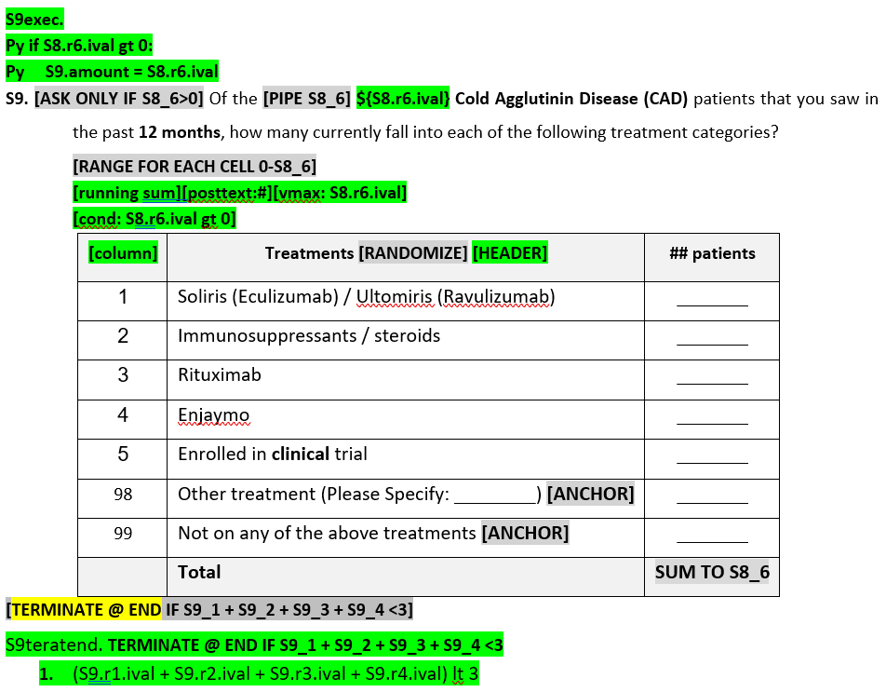
Example: frequent numerical question (2)
Python code to add a limit to the sum of the answers to a question
Text bolding, underline and hyperlinks are automatic hyperlinks
Validation for rows
In green color are marked needed changes in original document
Number question with running sum total
A row that starts with [column] indicates that in this row are column (here only one “## patients”)
A separate questions for termination

Slide 11


------------
<condition label="Disp9" cond='(S9.r1.ival + S9.r2.ival + S9.r3.ival + S9.r4.ival) lt 3’>Cond Disp 1 </condition>
------------
<row label="r9" value="1">S9@end </row>
------------
<exec sst='0’>
if S8.r6.ival gt 0:
S9.amount = S8.r6.ival
</exec>
<suspend/>
<number
label='S9’ cond='S8.r6.ival gt 0’
ss:postText=‘#’ rowLegend='left’
uses='autosum.5’ size=‘5v' grouping='cols’
autosum:prefill='0' ss:listDisplay='0’>
<title>
<b> </b> Of the <b> ${ S8.r6.ival} Cold Agglutinin Disease (CAD)</b> patients that you saw in the past <b>12 months</b>,
how many currently fall into each of the following treatment categories? <br/><br/> <br/><br/>
</title>
<validate>
for x in this.rows:
if x.displayed:
if(this[x].ival gt S8.r6.ival):
error(res.S9err %(S8.r6.ival, x.text, this[x].c1.ival) ,row=x)
x=this.r98.ival
y=this.r98.open
if x&gt;0 and y==‘’:
error(res.otherx)
if y!='' and x==0:
error(res.othery);
</validate>
<row label='r1'>Soliris (Eculizumab) / Ultomiris (Ravulizumab)</row>
<row label='r2'>Immunosuppressants / steroids</row>
<row label='r3'>Rituximab</row>
<row label='r4'>Enjaymo</row>
<row label='r5'>Enrolled in <b>clinical</b> trial</row>
<row label='r98' randomize='0' open='1' openSize='25' openOptional='1' optional='1' >Other treatment (Please Specify: )</row>
<row label='r99' randomize='0' >Not on any of the above treatments</row>
<col label=‘c1' >## patients</col>
</number>
<suspend/>
<note> Original Cond=(S9.r1.ival + S9.r2.ival + S9.r3.ival + S9.r4.ival) lt 3</note>
<term label='Term9' cond="((S8.r6.ival gt 0) and processTerms('Disp1') and (QHidStage.r2) )"> Terminate S9teratend </term> <suspend/>
Code from previous Question (Explanation)
Bolding
?
Condition from question is also written in the question termination. Systematization of work
Specify ->Systematization

Slide 12
Benefits: Term Conditions are ready for Template
<condition label="Disp1" cond="(ADVER1.r2)">Conditional Disposition 1</condition>
<condition label="Disp2" cond="(S1.r5)">Conditional Disposition 2</condition>
<condition label="Disp3" cond="(N1.r2)">Conditional Disposition 3</condition>
<condition label="Disp4" cond="(N2.r3)">Conditional Disposition 4</condition>
<condition label="Disp5" cond="(N2.r4)">Conditional Disposition 5</condition>
<condition label="Disp6" cond="(not N3.r1.check('3-35'))">Conditional Disposition 6</condition>
<condition label="Disp7" cond="(N4.r1 or N4.r3 or N4.r4 or N4.r5 or N4.r6 or N4.r7 or N4.r8)">Conditional Disposition 7</condition>
<condition label="Disp8" cond="(N5.r1.check('&lt;75'))">Conditional Disposition 8</condition>
<condition label="Disp9" cond="(N6.r6)">Conditional Disposition 9</condition>
<condition label="Disp10" cond="(N6.r5 or N6.r7)">Conditional Disposition 10</condition>
<condition label="Disp11" cond="(not (N7.r4 or N7.r5))">Conditional Disposition 11</condition>
<condition label="Disp12" cond="(S7a.r1.check('&lt;20'))">Conditional Disposition 12</condition>
<condition label="Disp13" cond="(S7b.r1.check('&lt;15'))">Conditional Disposition 13</condition>
<condition label="Disp14" cond="(PA1.r5)">Conditional Disposition 14</condition>
<condition label="Disp15" cond="(not PA2.r1.check('3-35'))">Conditional Disposition 15</condition>
<condition label="Disp16" cond="(PA3a.r7)">Conditional Disposition 16</condition>
<condition label="Disp17" cond="(not (PA4.r8))">Conditional Disposition 17</condition>
<condition label="Disp18" cond="(A1.r1)">Conditional Disposition 18</condition>
<condition label="Disp19" cond="(A2.r2)">Conditional Disposition 19</condition>
<condition label="Disp20" cond="(not A3.r1.check('3-35'))">Conditional Disposition 20</condition>
<condition label="Disp21" cond="(A4a.r2 or A4a.r4)">Conditional Disposition 21</condition>
<condition label="Disp22" cond="(S4b.r1)">Conditional Disposition 22</condition>
<condition label="Disp23" cond="(A5a.r1 or A5a.r2 or A5a.r3)">Conditional Disposition 23</condition>
<condition label="Disp24" cond="(A5b.r1 or A5b.r2 or A5b.r3)">Conditional Disposition 24</condition>
<condition label="Disp25" cond="(PH1.r8 or PH1.r9)">Conditional Disposition 25</condition>
<condition label="Disp26" cond="(PH1.r5)">Conditional Disposition 26</condition>
<condition label="Disp27" cond="(PH2.r3)">Conditional Disposition 27</condition>
<condition label="Disp28" cond="(PH2.r2)">Conditional Disposition 28</condition>
<condition label="Disp29" cond="(not PH3.r1.check('3-35'))">Conditional Disposition 29</condition>
<condition label="Disp30" cond="(PH4a.r6)">Conditional Disposition 30</condition>
<condition label="Disp31" cond="(PH4a.r7)">Conditional Disposition 31</condition>
<condition label="Disp32" cond="(PH5.r1.check('&lt;75'))">Conditional Disposition 32</condition>
<condition label="Disp33" cond="(not (PA6.r4 or PA6.r5))">Conditional Disposition 33</condition>
<condition label="Disp34" cond="(PH7a.r1.check('1-19'))">Conditional Disposition 34</condition>
<condition label="Disp35" cond="(PH7a.r1.check('=0'))">Conditional Disposition 35</condition>
<condition label="Disp36" cond="(PH7b.r1.check('1-14'))">Conditional Disposition 36</condition>
<condition label="Disp37" cond="(PH7b.r1.check('=0'))">Conditional Disposition 37</condition>
<condition label="Disp38" cond="(PH8.r3.check('&gt;50') or PH8rec.r3)">Conditional Disposition 38</condition>
<condition label="Disp39" cond="(S9.r1)">Conditional Disposition 39</condition>
<condition label="Disp40" cond="(S10.r1)">Conditional Disposition 40</condition>
<condition label="Disp41" cond="(S11.r1)">Conditional Disposition 41</condition>
<condition label="Disp42" cond="(S12.r1)">Conditional Disposition 42</condition>
<condition label="Disp43" cond="(S15.r1)">Conditional Disposition 43</condition>
Extreme example with 43 terminations (let say average is about 20)
It is possible to set the termination counter to the initial value, which is convenient for larger updates

Slide 13
Benefits: Termination list is ready for template
<row label="r1" value="1">Terminate -- ADVER1 </row>
<row label="r2" value="2">Terminate -- S1 </row>
<row label="r3" value="3">Terminate -- N1@end </row>
<row label="r4" value="4">Terminate -- N2 </row>
<row label="r5" value="5">Terminate -- N2@end </row>
<row label="r6" value="6">Terminate -- N3@end </row>
<row label="r7" value="7">Terminate -- N4 </row>
<row label="r8" value="8">Terminate -- N5@end</row>
<row label="r9" value="9">Terminate -- N6 </row>
<row label="r10" value="10">Terminate -- N6@end </row>
<row label="r11" value="11">Terminate -- N7 </row>
<row label="r12" value="12">Terminate -- S7a@end</row>
<row label="r13" value="13">Terminate -- S7b@end</row>
<row label="r14" value="14">Terminate -- PA1@end </row>
<row label="r15" value="15">Terminate -- PA2@end</row>
<row label="r16" value="16">Terminate -- PA3a@end </row>
<row label="r17" value="17">Terminate -- PA4@end</row>
<row label="r18" value="18">Terminate -- A1 </row>
<row label="r19" value="19">Terminate -- A2@end </row>
<row label="r20" value="20">Terminate -- A3@end</row>
<row label="r21" value="21">Terminate -- A4a@end </row>
<row label="r22" value="22">Terminate -- S4b@end </row>
<row label="r23" value="23">Terminate -- A5a@end </row>
<row label="r24" value="24">Terminate -- A5b@end </row>
<row label="r25" value="25">Terminate -- PH1 </row>
<row label="r26" value="26">Terminate -- PH1@end </row>
<row label="r27" value="27">Terminate -- PH2 </row>
<row label="r28" value="28">Terminate -- PH2@end </row>
<row label="r29" value="29">Terminate -- PH3@end</row>
<row label="r30" value="30">Terminate -- PH4a </row>
<row label="r31" value="31">Terminate -- PH4a@end </row>
<row label="r32" value="32">Terminate -- PH5@end</row>
<row label="r33" value="33">Terminate -- PH6 </row>
<row label="r34" value="34">Terminate -- PH7a@end</row>
<row label="r35" value="35">Terminate -- PH7a </row>
<row label="r36" value="36">Terminate -- PH7b@end</row>
<row label="r37" value="37">Terminate -- PH7b </row>
<row label="r38" value="38">Terminate -- PH8@end</row>
<row label="r39" value="39">Terminate -- S9 </row>
<row label="r40" value="40">Terminate -- S10 </row>
<row label="r41" value="41">Terminate -- S11 </row>
<row label="r42" value="42">Terminate -- S12@end </row>
<row label="r43" value="43">Terminate -- S15@end </row>

Slide 14
Benefits: Questions and Terminations
<checkbox label='S3' atleast='1’>
<title> What conditions have you been diagnosed with within the last 5 years? </title> <comment>Please select all that apply.</comment>
<row label='r1'>Ulcerative Colitis</row>
<row label='r2'>Diverticular Disease</row>
<row label='r3'>Crohn's Disease</row>
<row label='r4'>Irritable bowel syndrome</row>
<row label='r5'>Acid Reflux (GER &amp; GERD)</row>
</checkbox>
<suspend/>
<note> Original Cond=not S3.r1</note>
<term label='Term2' cond="(processTerms('Disp2') and (QHidStage.r2) )"> Terminate S3teratend </term>
<suspend/>
<radio label='S4’>
<title> Have you undergone Ileal pouch-anal anastomosis (IPAA) surgery within the last 5 years?</title> <row label='r1'>Yes</row>
<row label='r2'>No</row>
</radio>
<note> Original Cond=S4.r2</note>
<term label='Term3' cond="(processTerms('Disp3') )"> Terminate S4 </term>
<suspend/>
<radio label='S5’>
<title> Following Ileal pouch-anal anastomosis (IPAA) surgery, were you diagnosed with any of the following? </title>
<row label='r1'>Acute Pouchitis</row>
<row label='r2'>Chronic Pouchitis</row>
Questions and Terminations are immediately written one after the other
Term and Term at end can be solved too

Slide 15
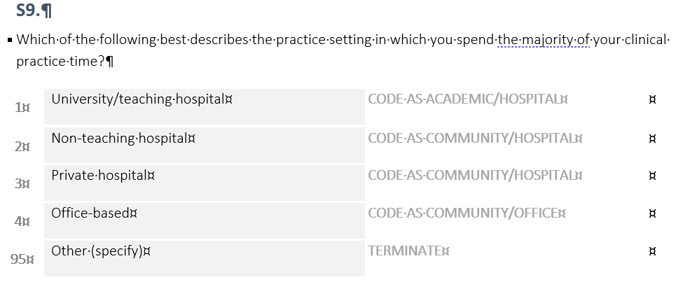
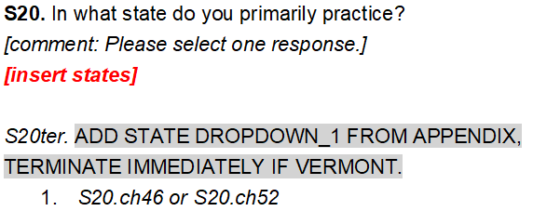

More examples of automatization
CODE AS keyword automatically create new hidden variable with hospital and office categories. Function for many categories as well
Automatically insert xml with states and additional hidden textual question for PMs
<row label="ch1"> Alabama</row>
<row label="ch2"> Alaska</row>
<row label="ch3"> Arizona</row>
<row label="ch4"> Arkansas</row>
<row label="ch5"> California</row>
<row label="ch6"> Colorado</row>
<row label="ch7"> Connecticut</row>
<row label="ch8"> Delaware</row>

Slide 16
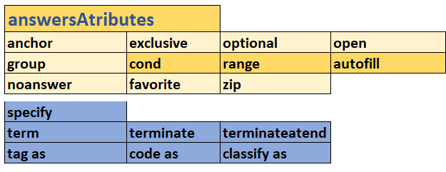
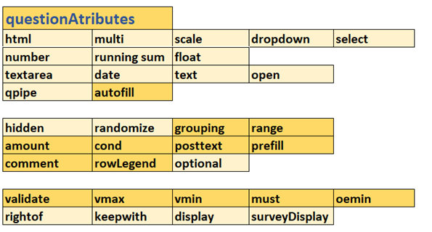
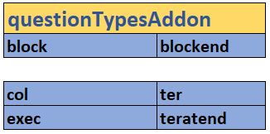
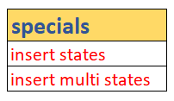

All Orders Grouped by Types

Slide 17
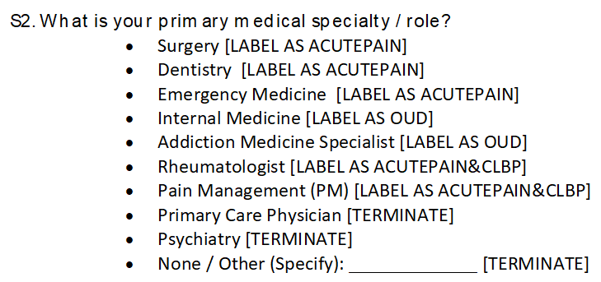
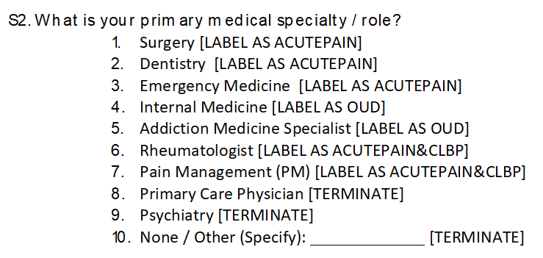
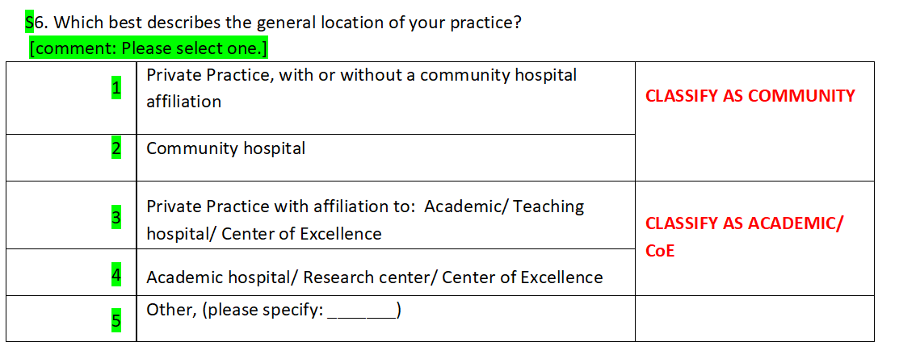
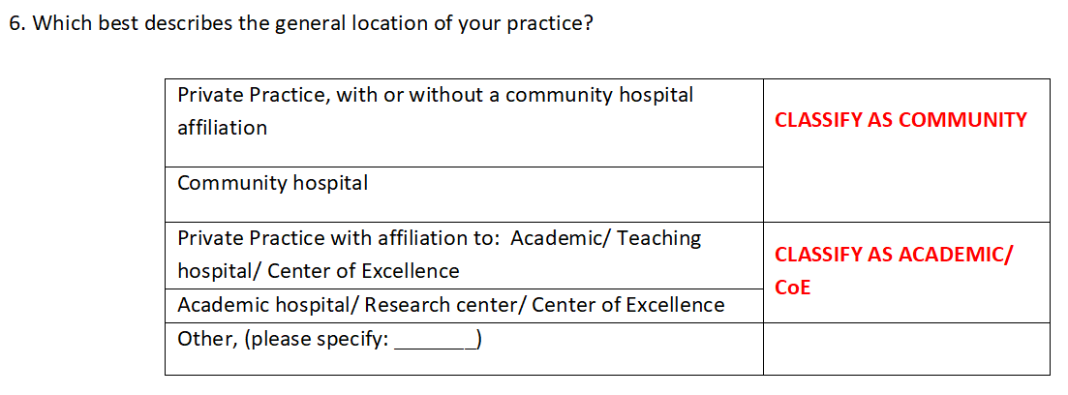
Examples of questions when reformatting needed to be done prior to importing
One click in Microsoft Word, and we get the numbers
We have to add a column to the left and other added things are in the green color

Slide 18
Error List Examples (if errors) (helps to correct notation before importing)
Number of left and right square brackets is not equal:: S80::answerNumber::2
Error in question:S1 double answers:3
Brackets [] Inside Brackets []::Question::S1
Duplicate question name:S2

Slide 19
pro and con
pro
con
Systematic errors may occur (after updates of the program)
Format in Word sometimes need to be done prior importing
Buggs (exist and will be discovered)
Testing must be done in Decipher xml editor
Install on individual computers
GitHub not used (yet)
I am not developer
Importing question from Word
logic and termination can be entered too
Extendable to QUANT
Can be extended out of Decipher
Work systematicity can be improved
Copy/Paste reduction
List of Errors
Can be used for huge updates
Written in an object-oriented manner

Slide 20
List of Used Python Modul
python-docx (Document, Paragraph, Table) - work with Word Documents
VBA (only small parts od code: ConvertListToNumber, Hyperlinks)
pandas - manipulating data
re - regular expressions
Unicode data
pywin32 - OS functions
os - OS functions
shutil - high-level operations on files
Enum - symbolic names

Slide 21
Caution when spreading the program to the team
First, it is necessary to pilot the program with an experienced programmer and fix bugs and improve some functional solutions. Let's see if this is an acceptable solution for team
Group and individual education required
For the first use on live projects, at least some 10 already solved projects is required for trenning

Slide 22
What’s next
Automatization of the QUAL template?
Word to Xlates? (quicker translations formatting for Xlates)
Preparing the post programming (e.g. data analyst)?
…

Slide 23
Thanks to all Qual Team Members wherever they are

